Slide 1
BACHELOR OF ENGINEERING
FINAL PRESENTATION ON
DATA BACKUP INVENTORY MANAGEMENT SYSTEM
Department of Computer Science and Engineering
Chitkara University Institute of Engineering and Technology
Submitted By: UNDER THE SUPERVISION OF:
Tarandeep Singh Deepak Mehta.

Slide 2
Project Plan
Introduction.
Literature View.
Objectives.
Benefits.
Work Done.
Result.
References.

Slide 3
Introduction
File system backup can be defined as the collection of files and the file management structures on physical or logical storage.
Backups are initiated from the servers.
The User Panel helps the user to add the details of the backup tapes.
The Admin Panel can add new users and can grant privileges to the users.
We can have different types of backups of the systems i.e. daily backups, weekly backups, monthly backups and yearly backups.

Slide 4
Benefits
Higher Reliability – The biggest benefit of regular data backup is its great reliability. Backup can be automated and updated on a daily basis, weekly basis and monthly basis.
Greater Security – When you employ data backup, you store your data in a secure location, making it physically safe.
Ease of Recovery – Due to multiple levels of redundancy, if data is lost or deleted, most likely through individual user error or deletion, backups are available.
Easily Traceability – The user can keep the track of the backup tapes which are send back to the different locations.

Slide 5
Accountability – The admin keeps the track of the changes or the modifications done under the add backup and send backup.
Easy Searchable – The user can easily search for a backup tape by providing various details like date, month, year, category, location etc.

Slide 6
User Panel
The user have various privileges where he can perform different functions such as :
Add Backup.
Add Multiple Backup.
Available Backup Summary.
Daily/Monthly Backup Summary.
Search Backup.
Move Backup.
Send Backup.
Send/receive Backup Summary.
Report.

Slide 7
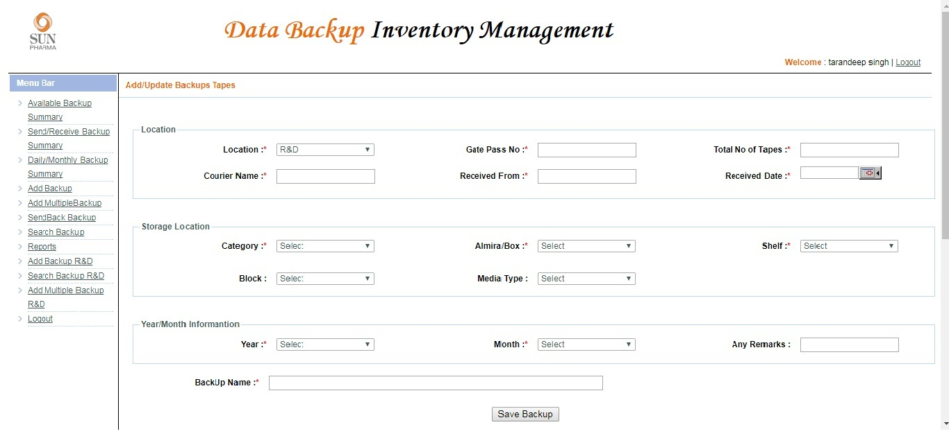
Add Backup
The add backup is used to add a record in the system. It has various fields which are filled by the user at the time of entering a new backup tape.

Slide 8
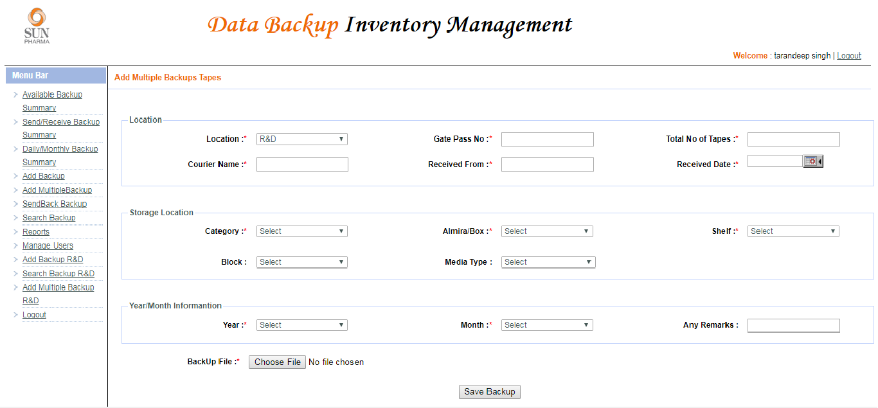
Add Multiple Backup
The add multiple backup is used to add multiple records in the system. It has various fields which are filled by the user at the time of entering a new backup tape, and a file has to be uploaded by the user which contains multiple backup data.

Slide 9
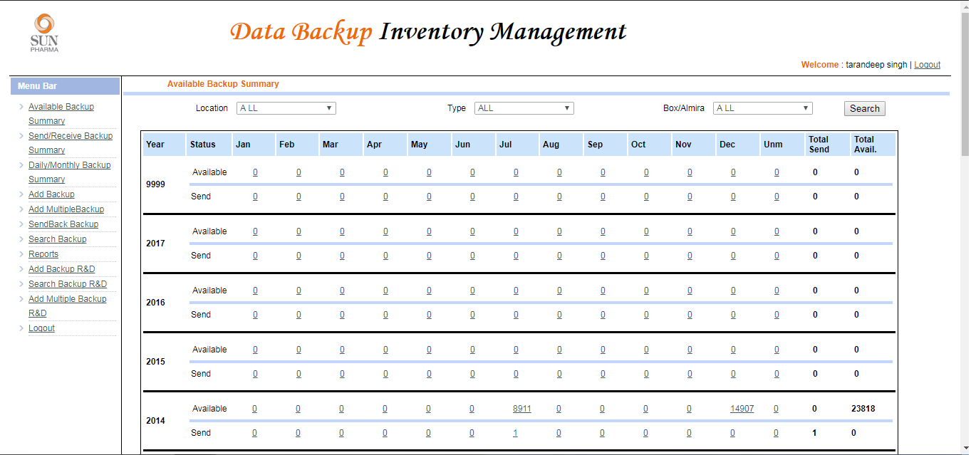
Available Backup Summary
The below picture shows us the summary of the available backups tapes in a location.

Slide 10
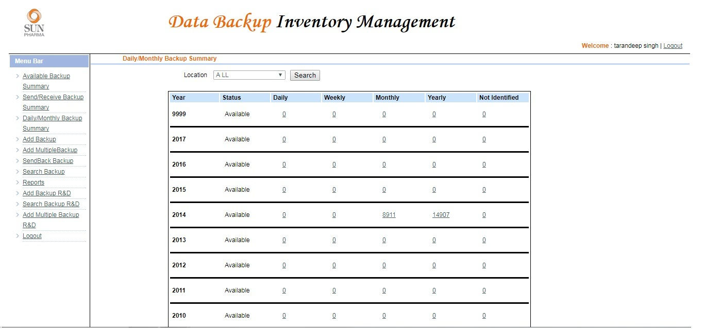
Daily/Monthly Backup Summary
The below picture shows the availability of backup tapes at a particular location, arranging them in daily, weekly, monthly and yearly.

Slide 11
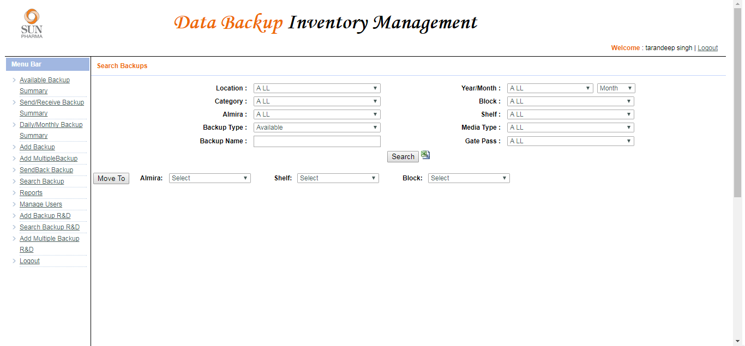
Search Backup
The search backup is used to search a record in the system. The user can search a backup tape with different filters.

Slide 12
Move Backup
The move backup is used to change the storage location of the tape in the system. The user can search a backup tape and can enter the location and reallocate the backup tape.

Slide 13
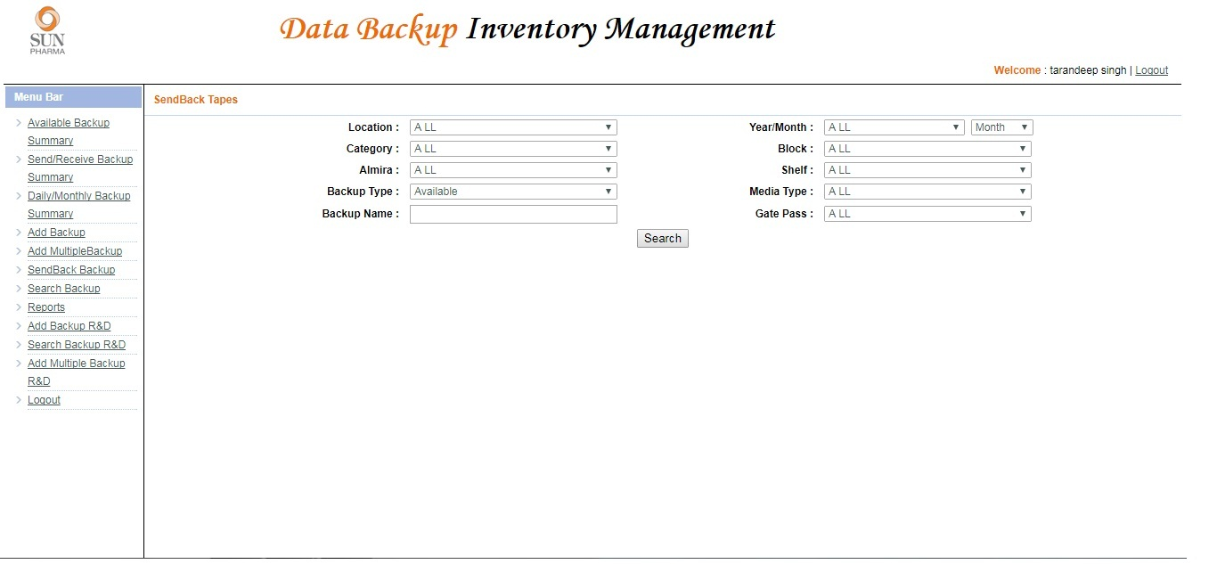
Send Backup
The user can send back the backup tapes to the location where it is necessary.

Slide 14
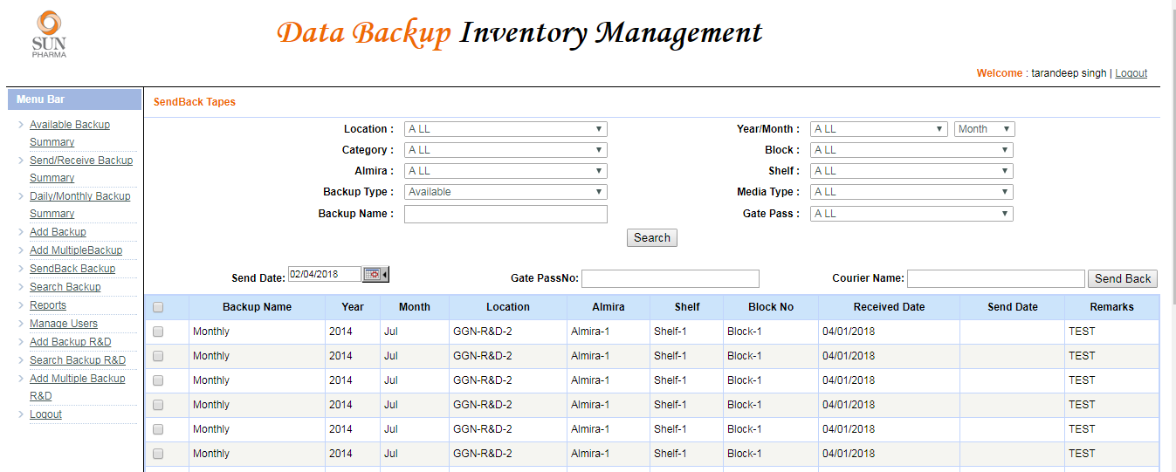
Send Backup

Slide 15
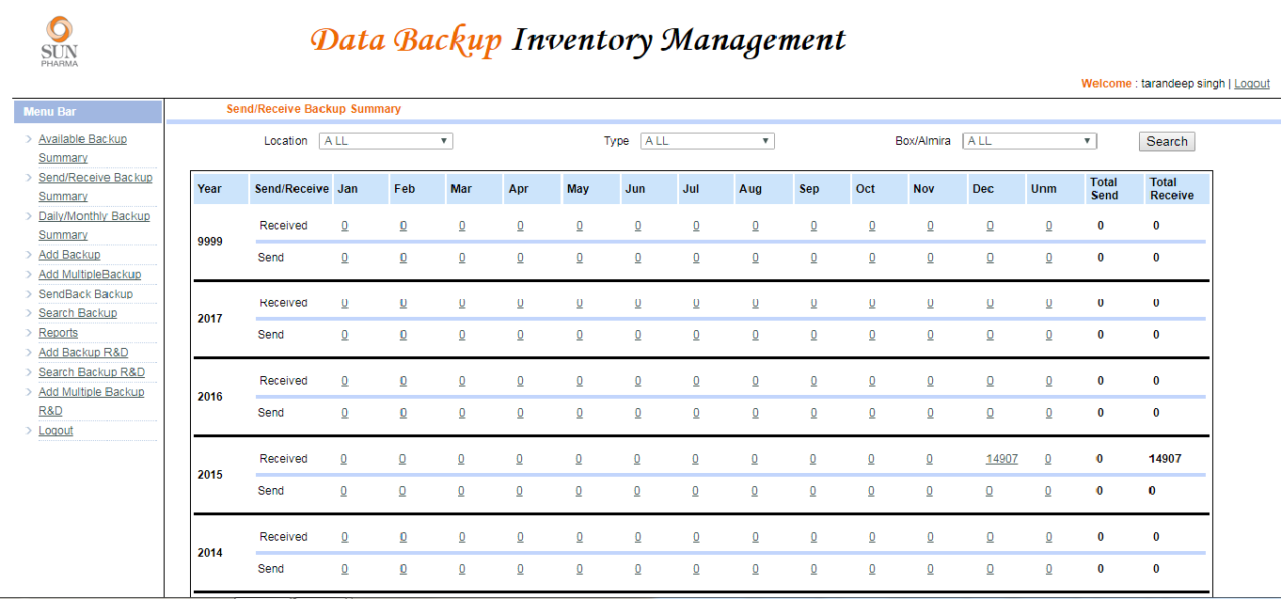
Send/Receive Backup Summary
The below picture shows the Tapes we have received yearly and the tapes we have sent back.

Slide 16
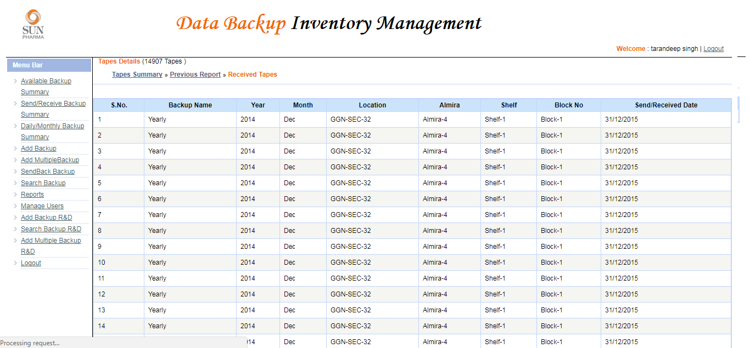
Detailed Receive Backup Summary
The below picture shows the tapes we have received in year 2014.

Slide 17
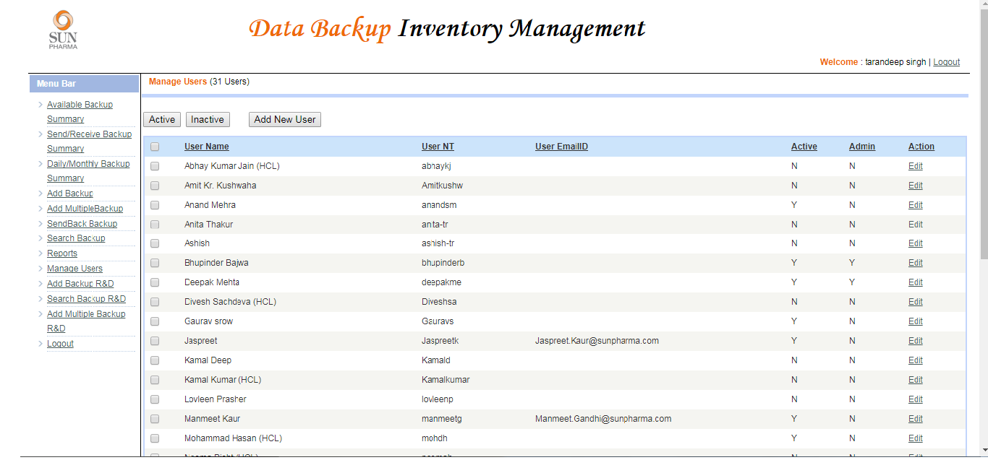
Reports
The user can download the report of the following:
Backup Log (In) Report. Year/Location wise Monthly Summary.
Backup Log (Out) Report. Year/Location wise Monthly Matrix.

Slide 18
Admin Panel
The admin can make a user Active or Inactive according to the requirement.

Slide 19
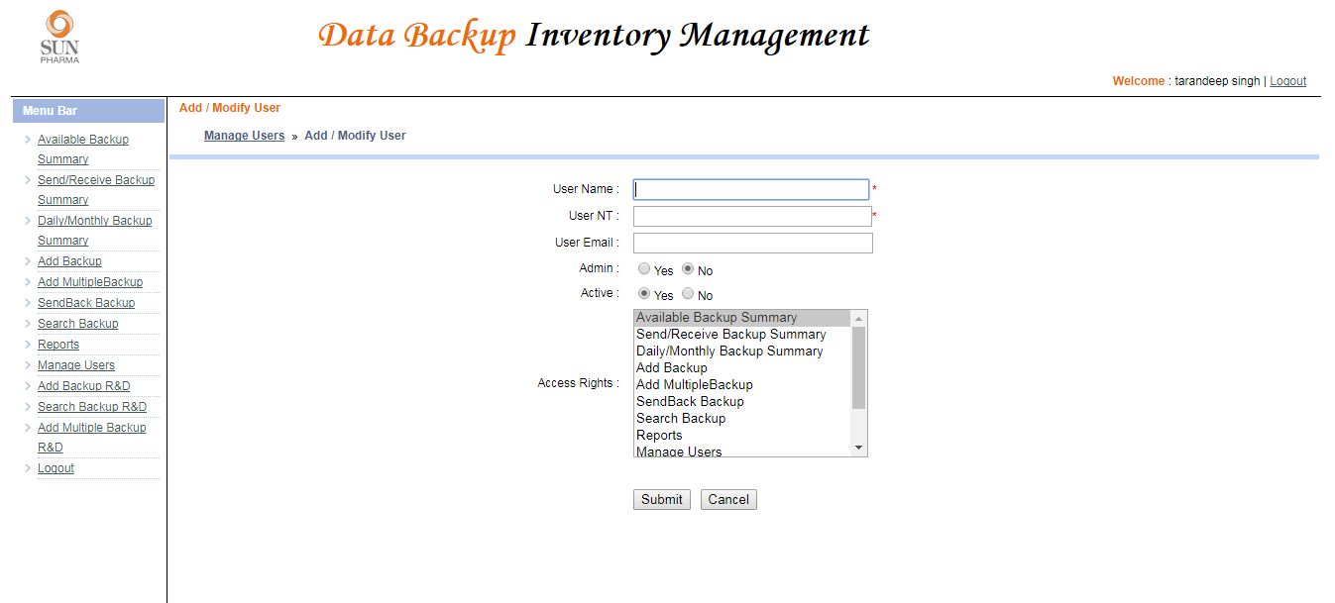
Admin Panel
The admin can Grand privileges to the users and can Add new users with required permissions.

